Slide 1
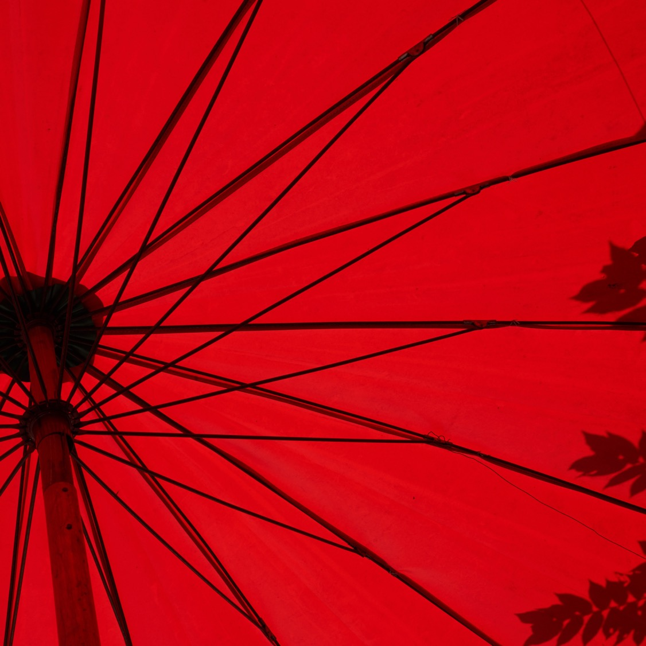
JAPAN
ヒンダ Ait Aissa
アレクサンダー Decarli
サラ Devigili

Slide 2

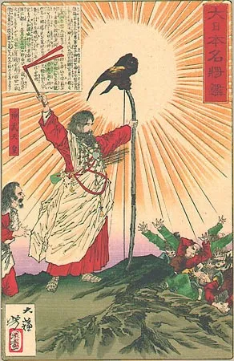
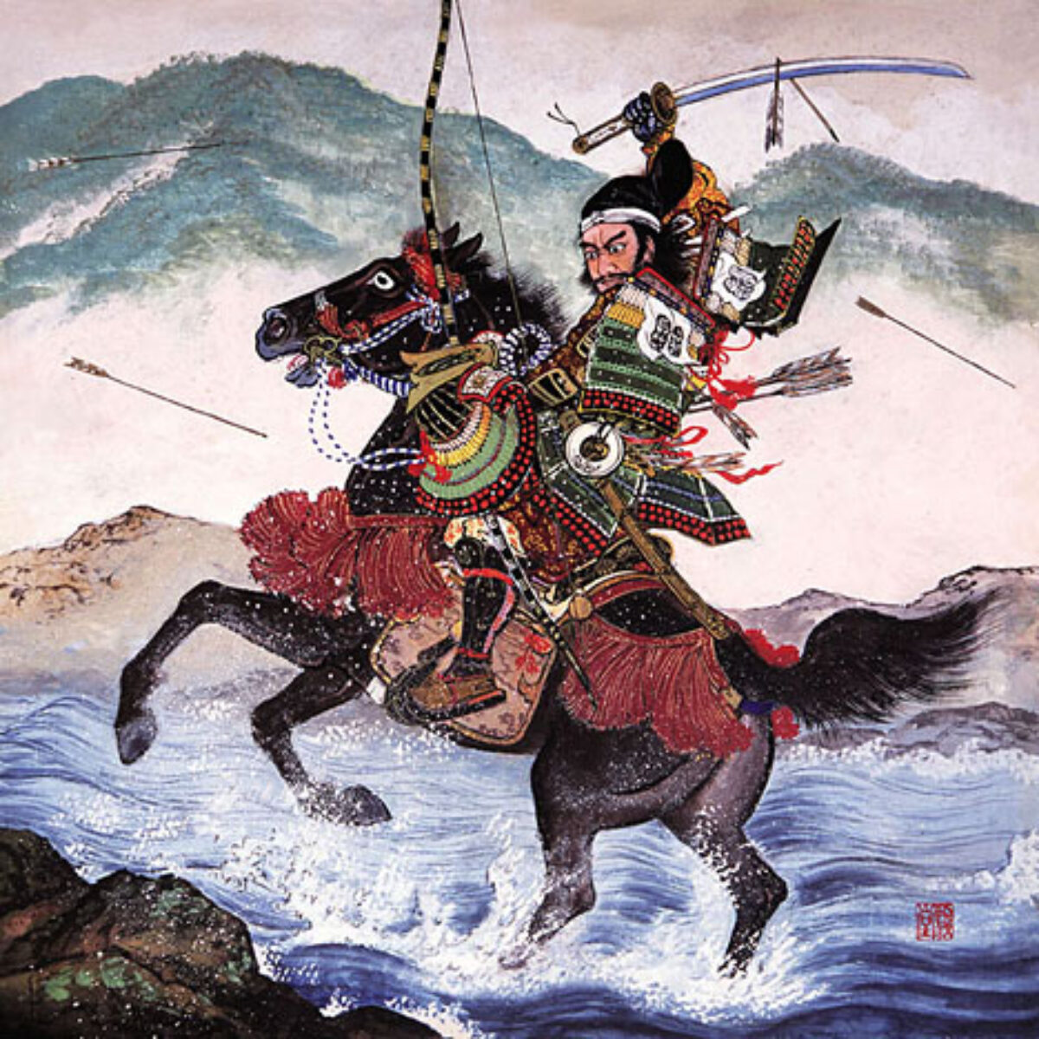
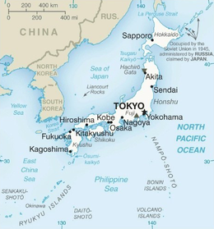
HISTORY AND GEOGRAPHY
歴史
2

Slide 3
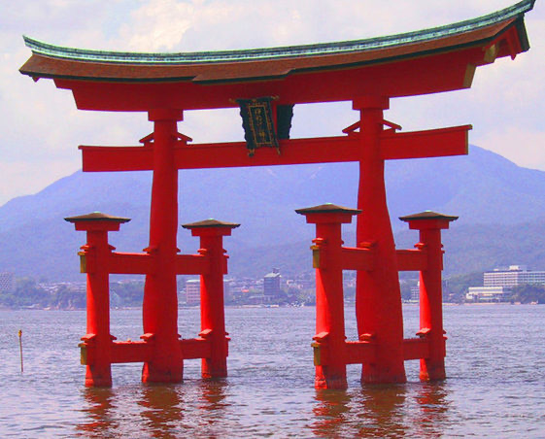
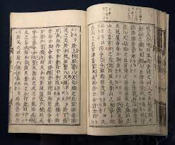
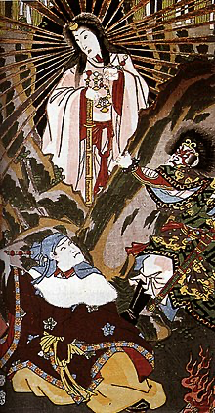
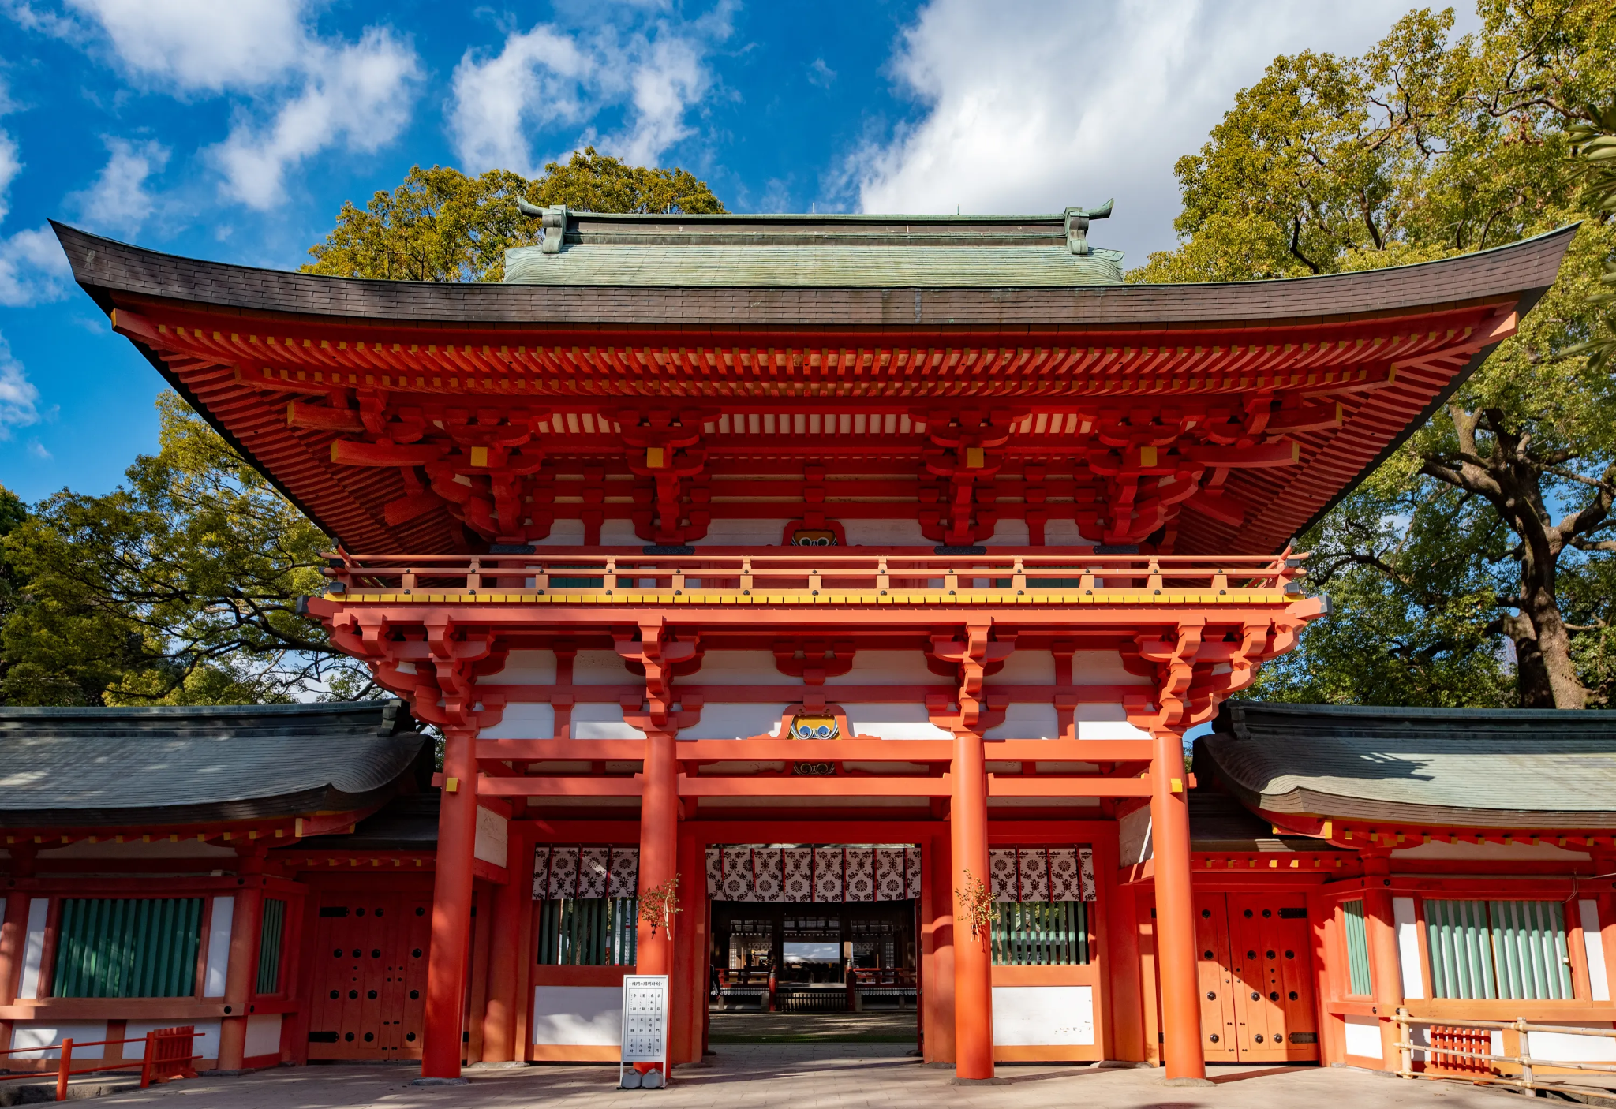
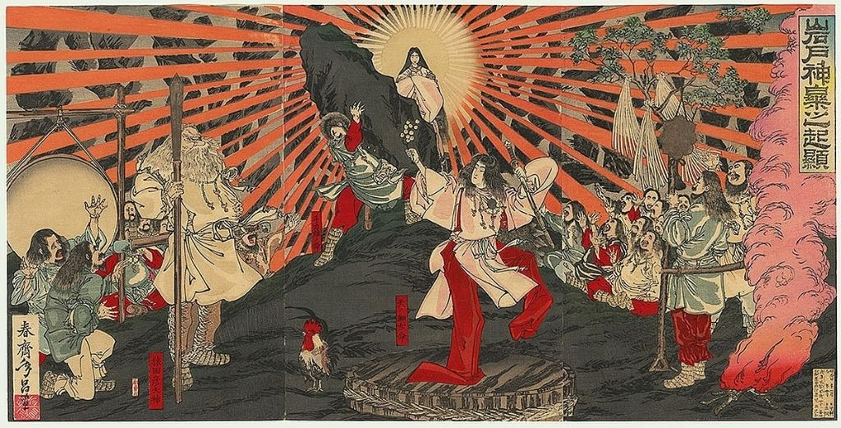
JAPANESE RELIGION: SHINTŌ
KOJIKI
KAMI is the Japanese word for a deity, divinity, or spirit. It has been used to describe mind, God, supreme being, one of the Shinto deities, an effigy, a principle, and anything that is worshipped.
3

Slide 4
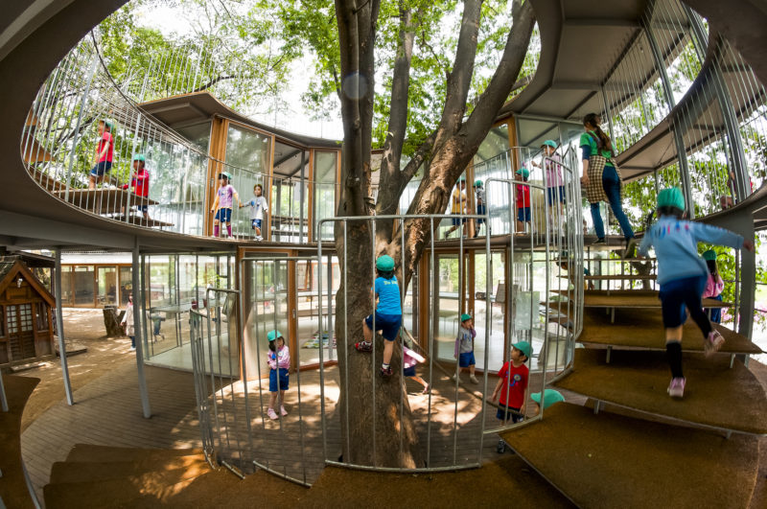
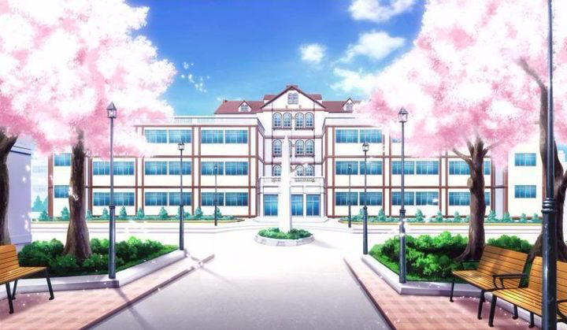
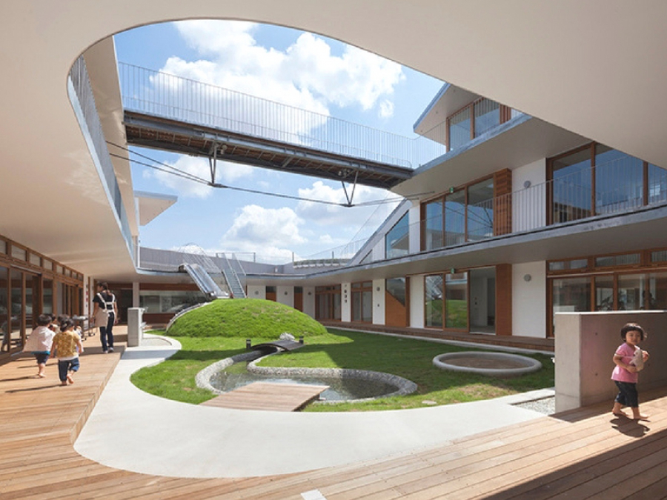
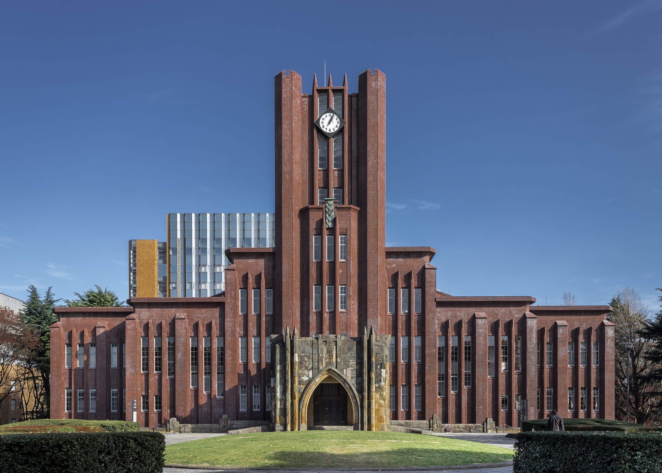
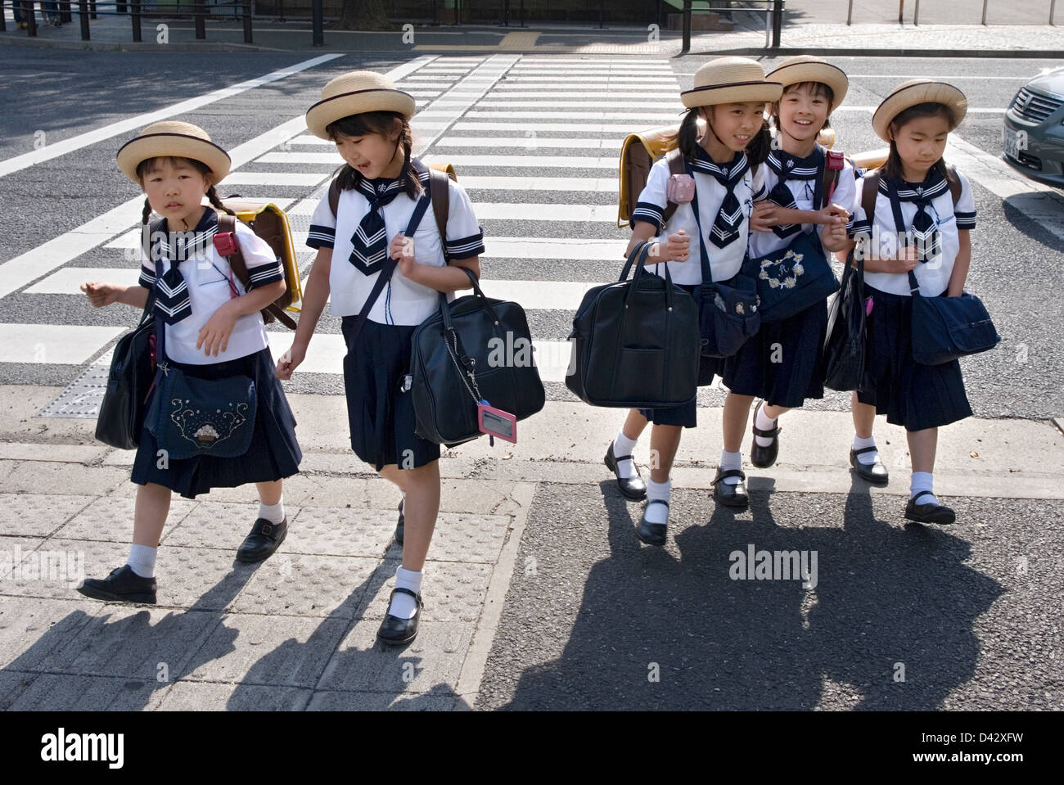
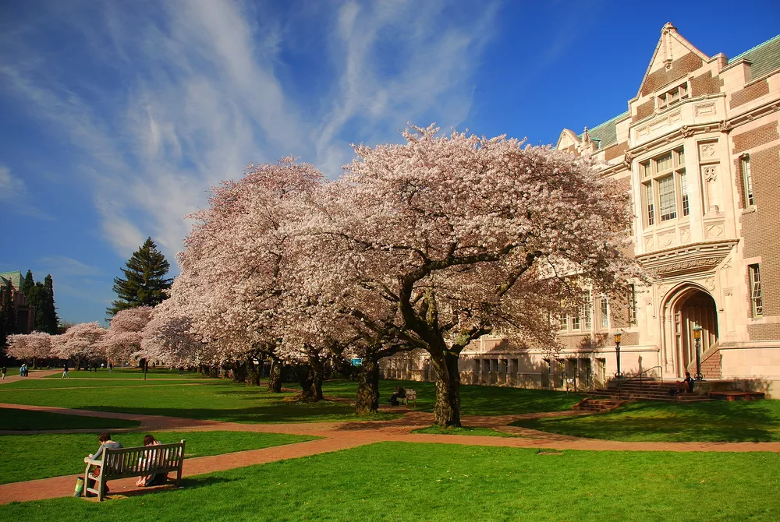
SCHOOL’S SYSTEM
Kindergarten (not compulsory but strongly recommended): from 3 to 6 years of age
Elementary school (compulsory): from 6 to 12 years of age
First level middle school (compulsory): from 12 to 15 years of age
Second level middle school (not compulsory): from 15 to 18 years of age
University college or vocational school: 18 to 22 years of age
Specialization (master's, doctorate, specialized costs, fee): from 22 to 24 years of age

Slide 5
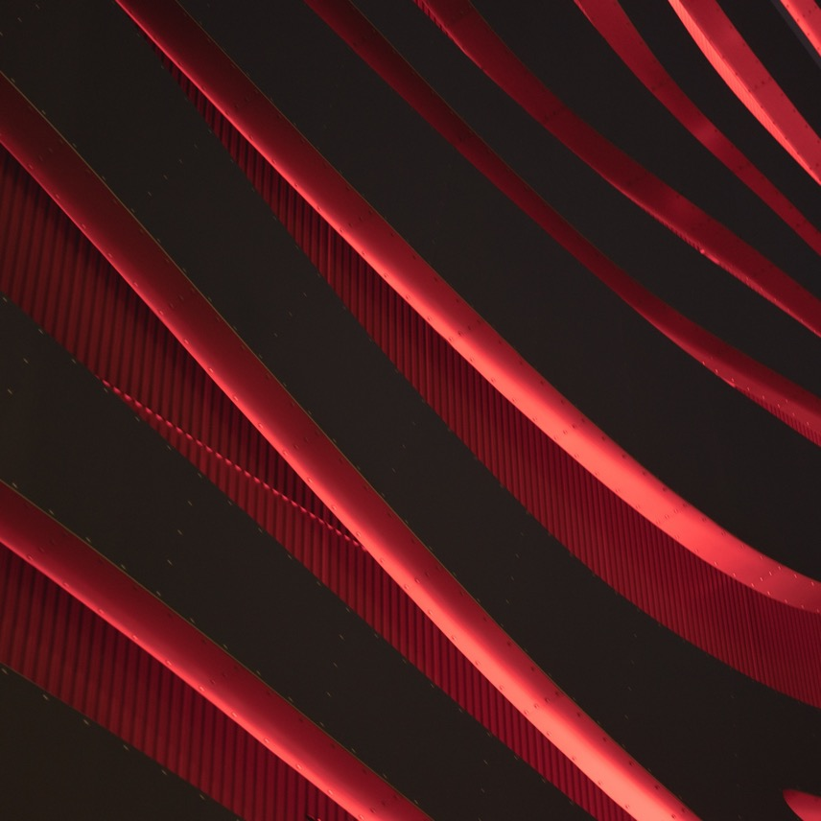
CULTURE
ヒンダ
How they speak? What is their language?
How and what they eat during the day?
How they can have fun in Japan?

Slide 6
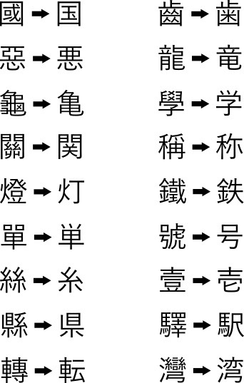
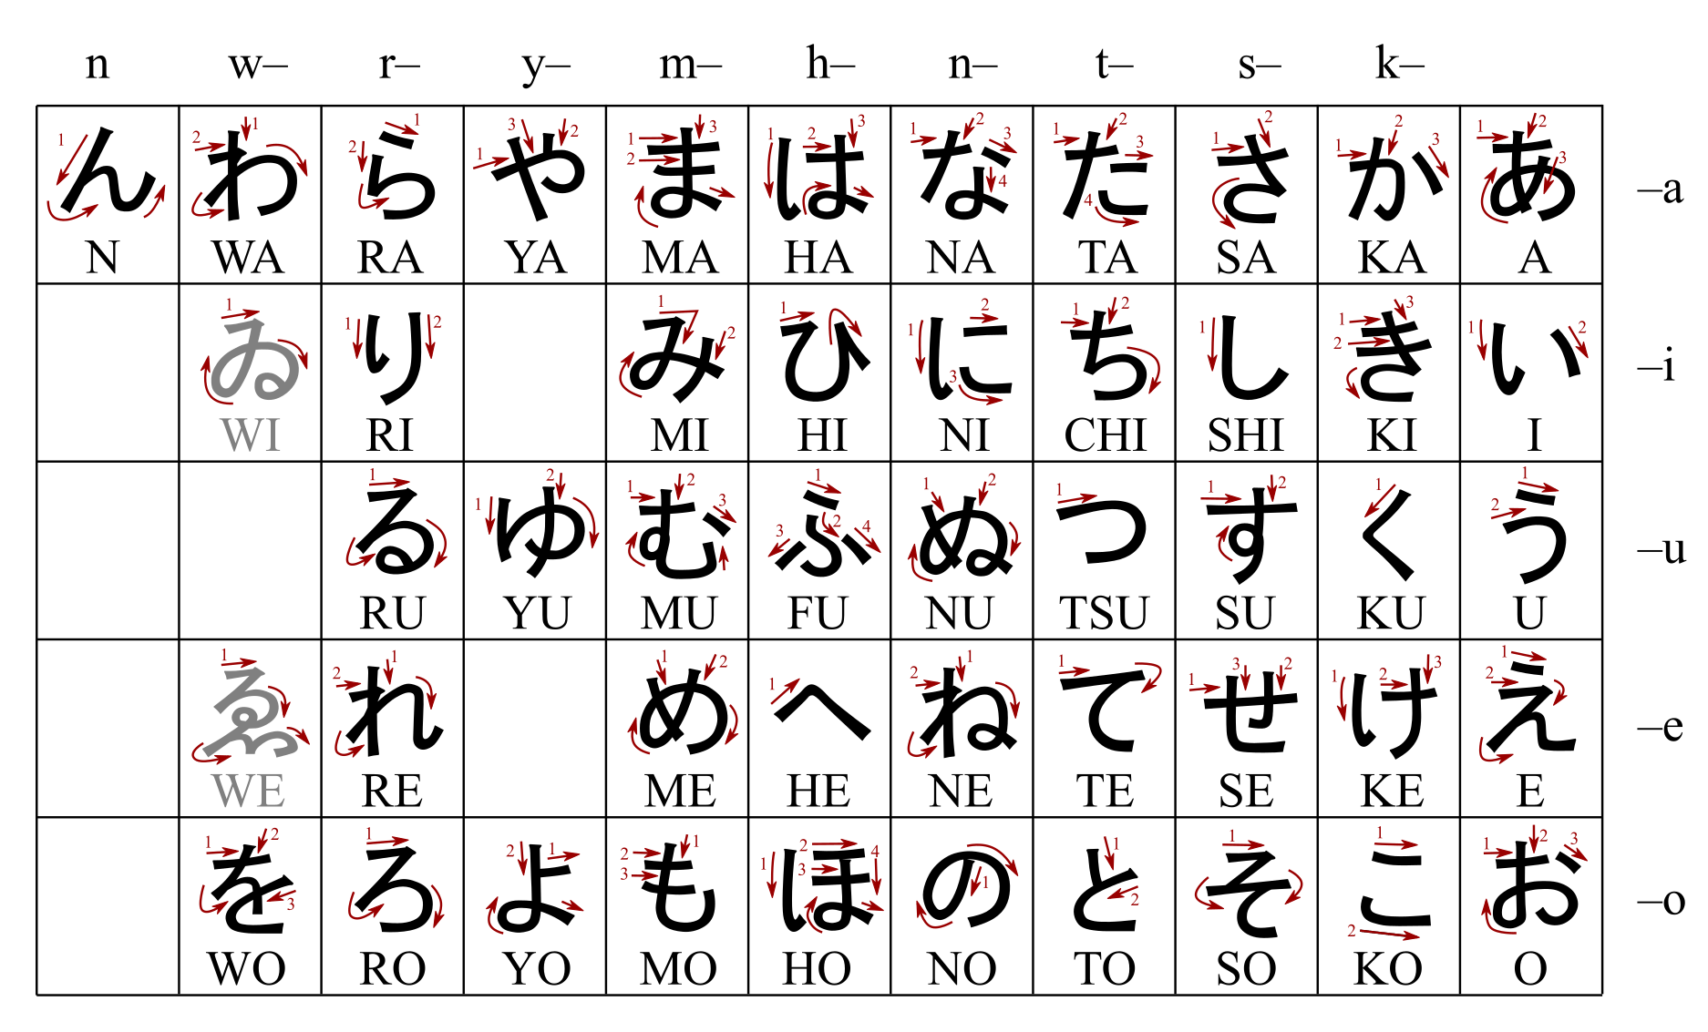
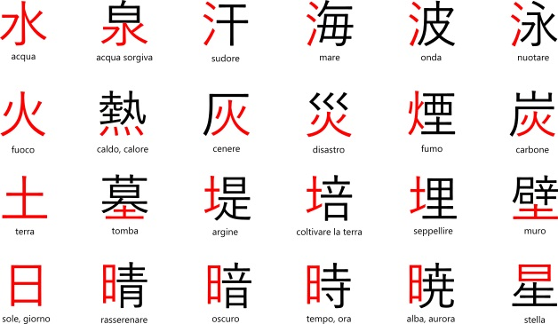
JAPANESE LANGUAGE
Nara period (8th century): application of Japanese words to equivalent Chinese ideograms
9th century a Japanese "phonetic alphabet"= Hiragana
In the Heian era:"The Story of Genji" (1021): Murasaki Shikibu
From 1338: introduction of Kanji
Today in Japan: Nihongo
(日本語)

Slide 7
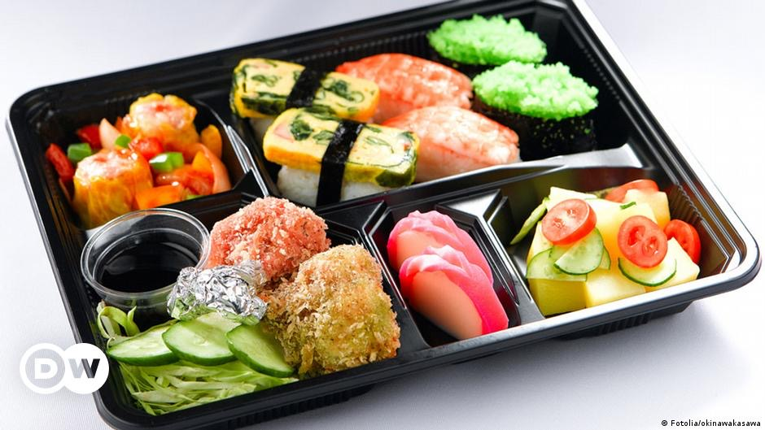
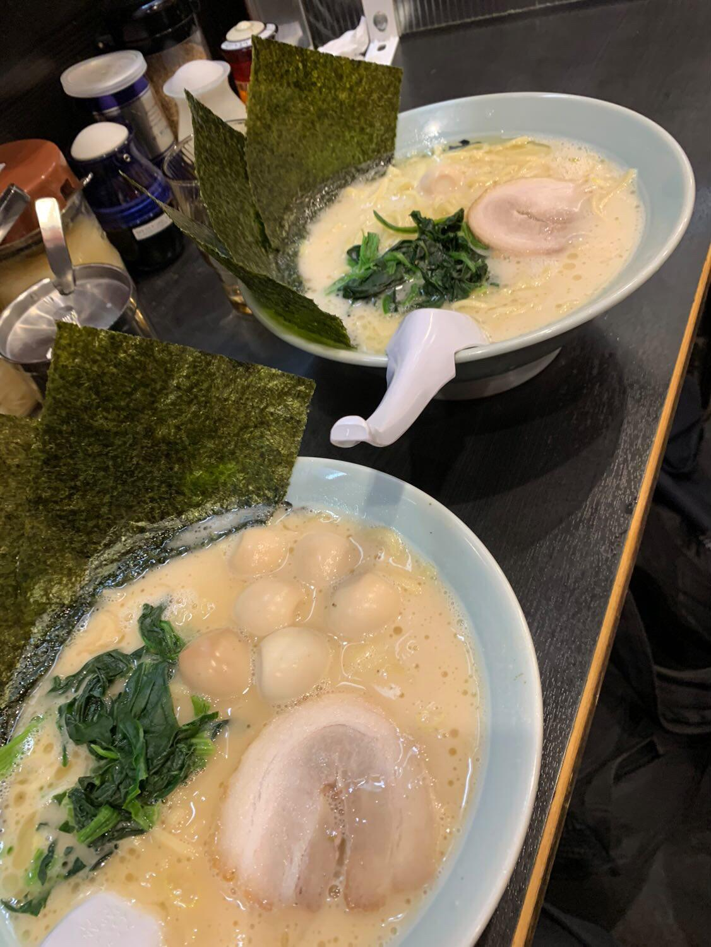
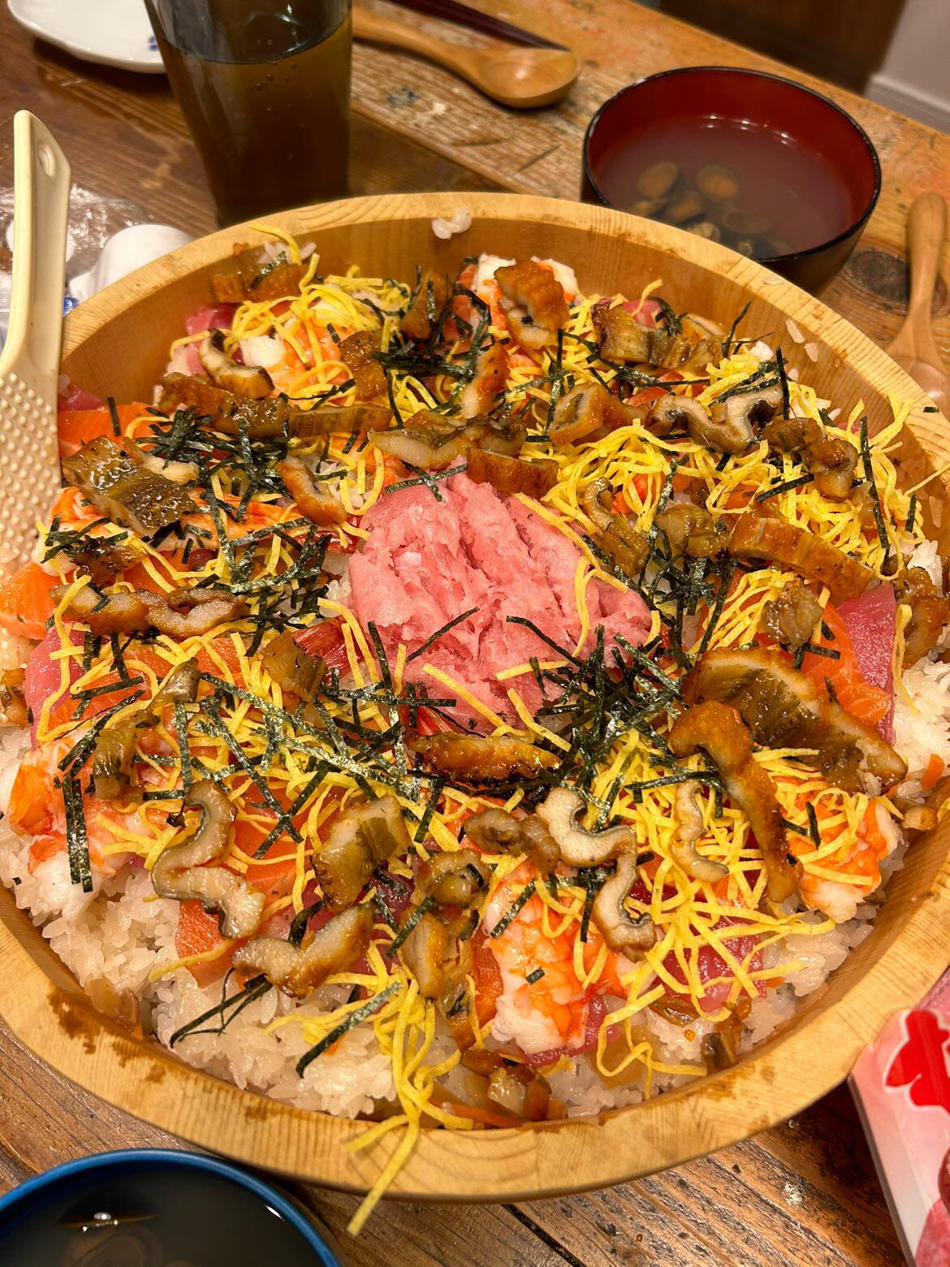
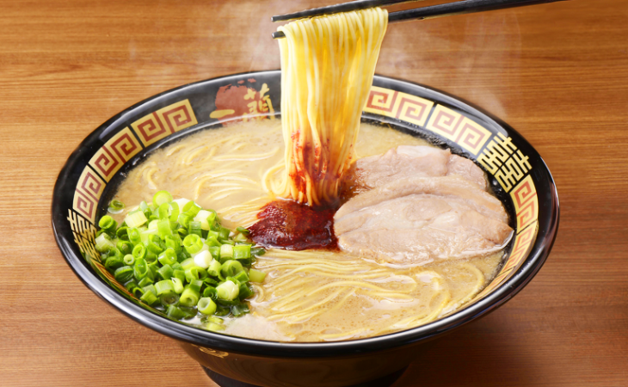
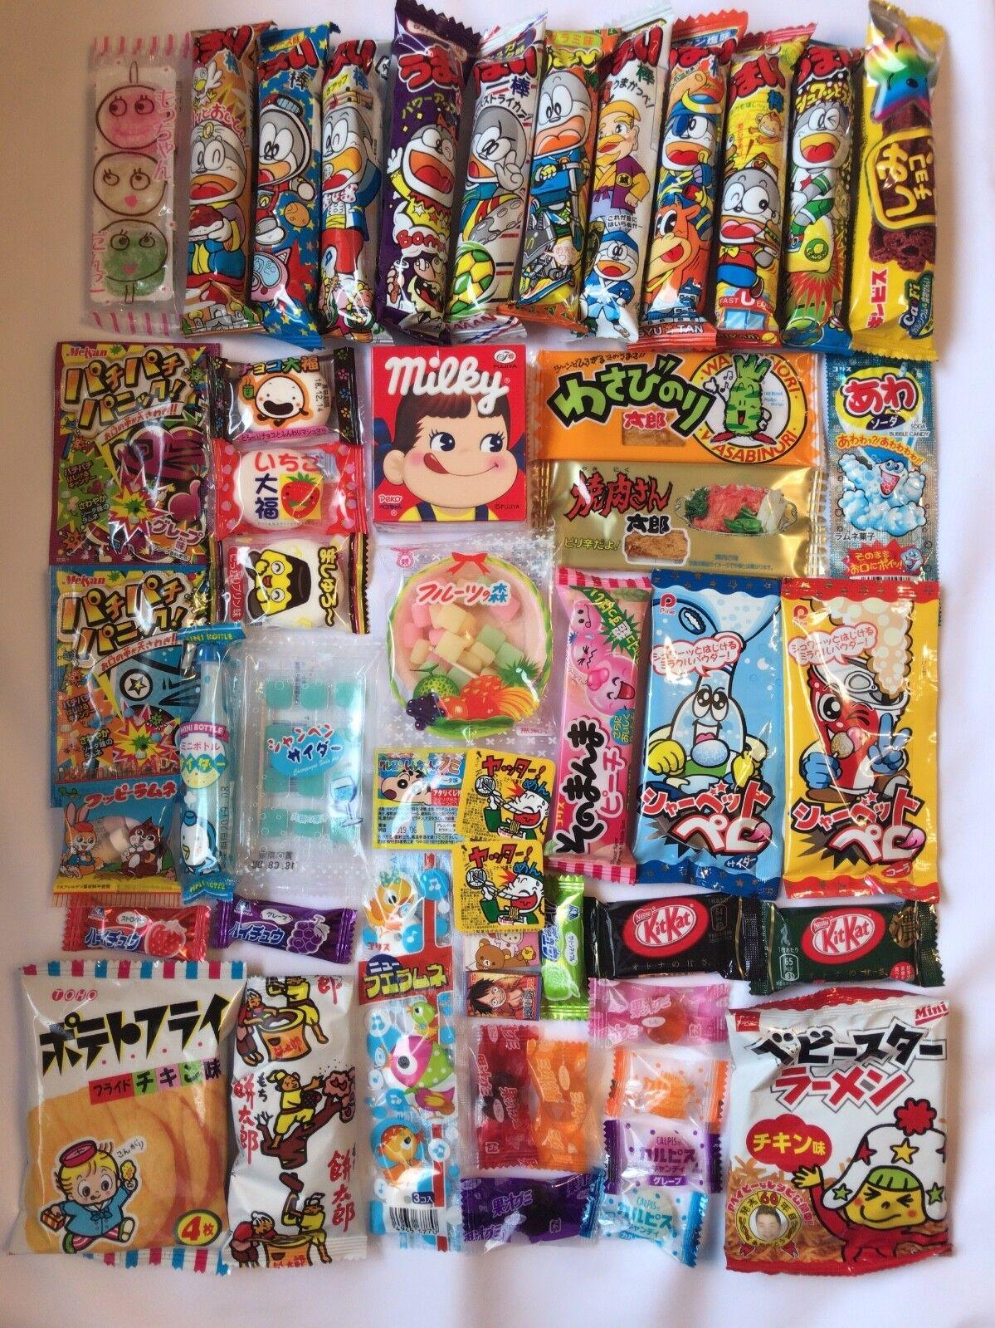
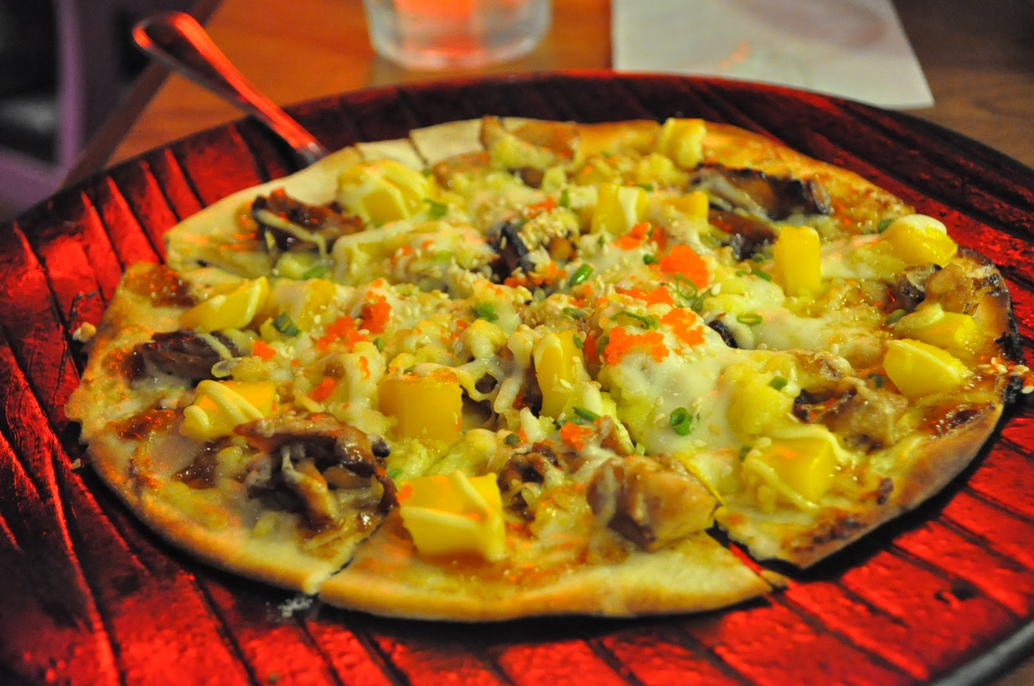
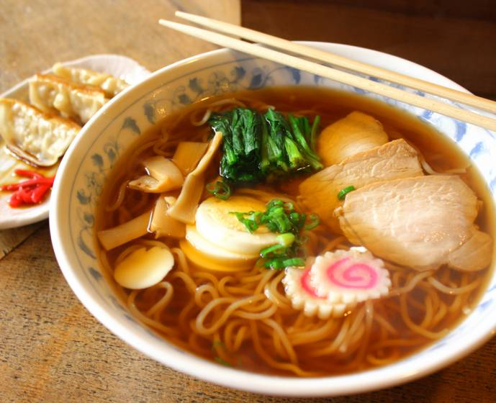
THE DIFFERENT MEALS IN JAPAN
.
In Japan, food consumption is organized around three main meals:
Breakfast —> traditional or western
Lunch —> eaten quickly at work or school
Dinner —> in small restaurants or bars such as izakaya or in street stalls (yatai)
Snack —> oyatsu and consists of a snacks called o-kashi with a drink that can be hot or cold (not alcoholic)

Slide 8
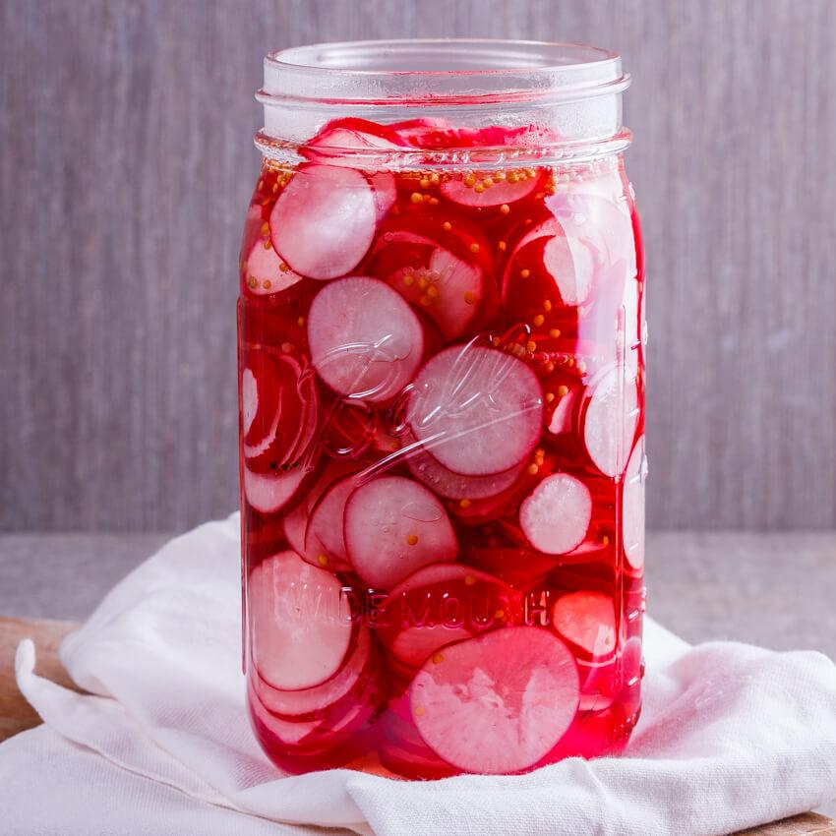
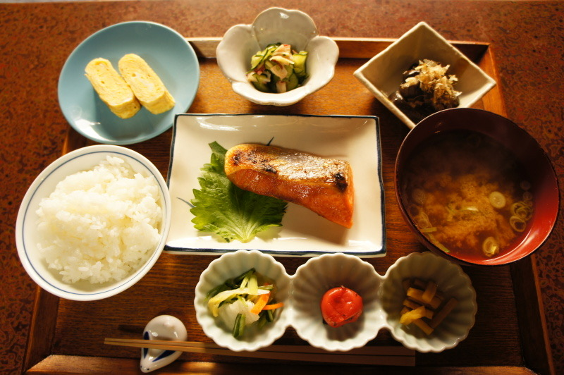
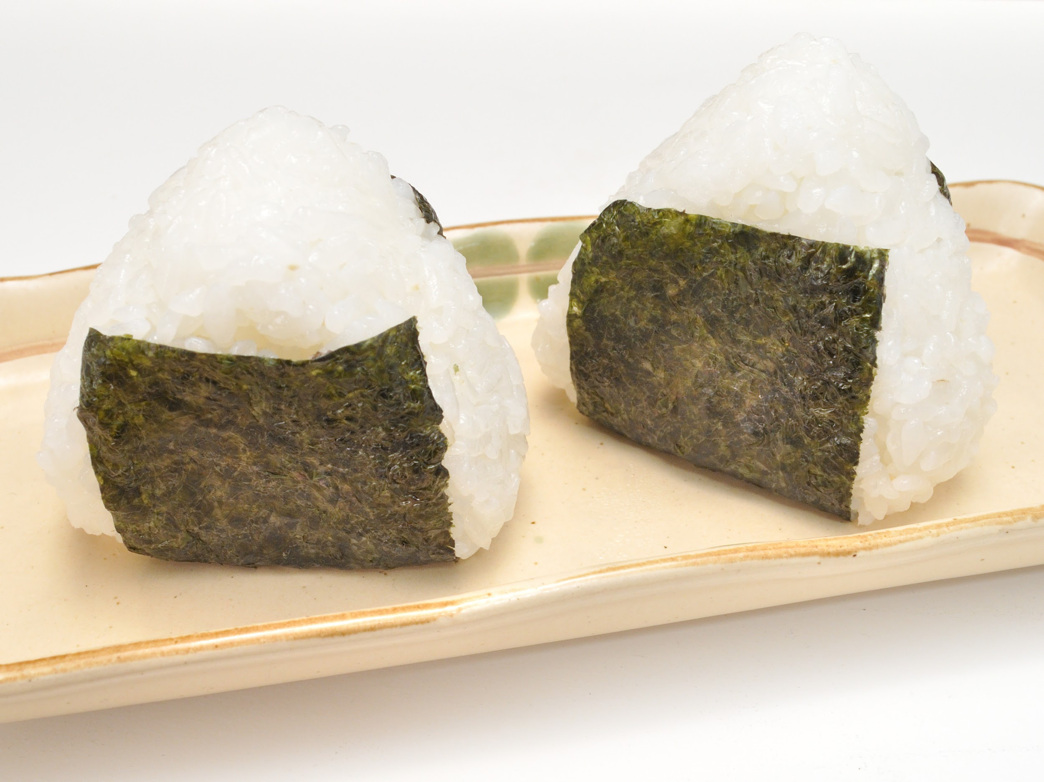
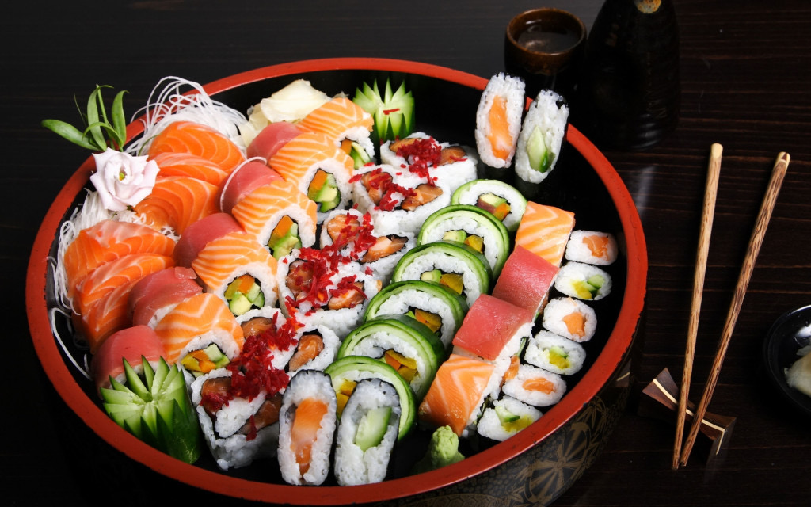
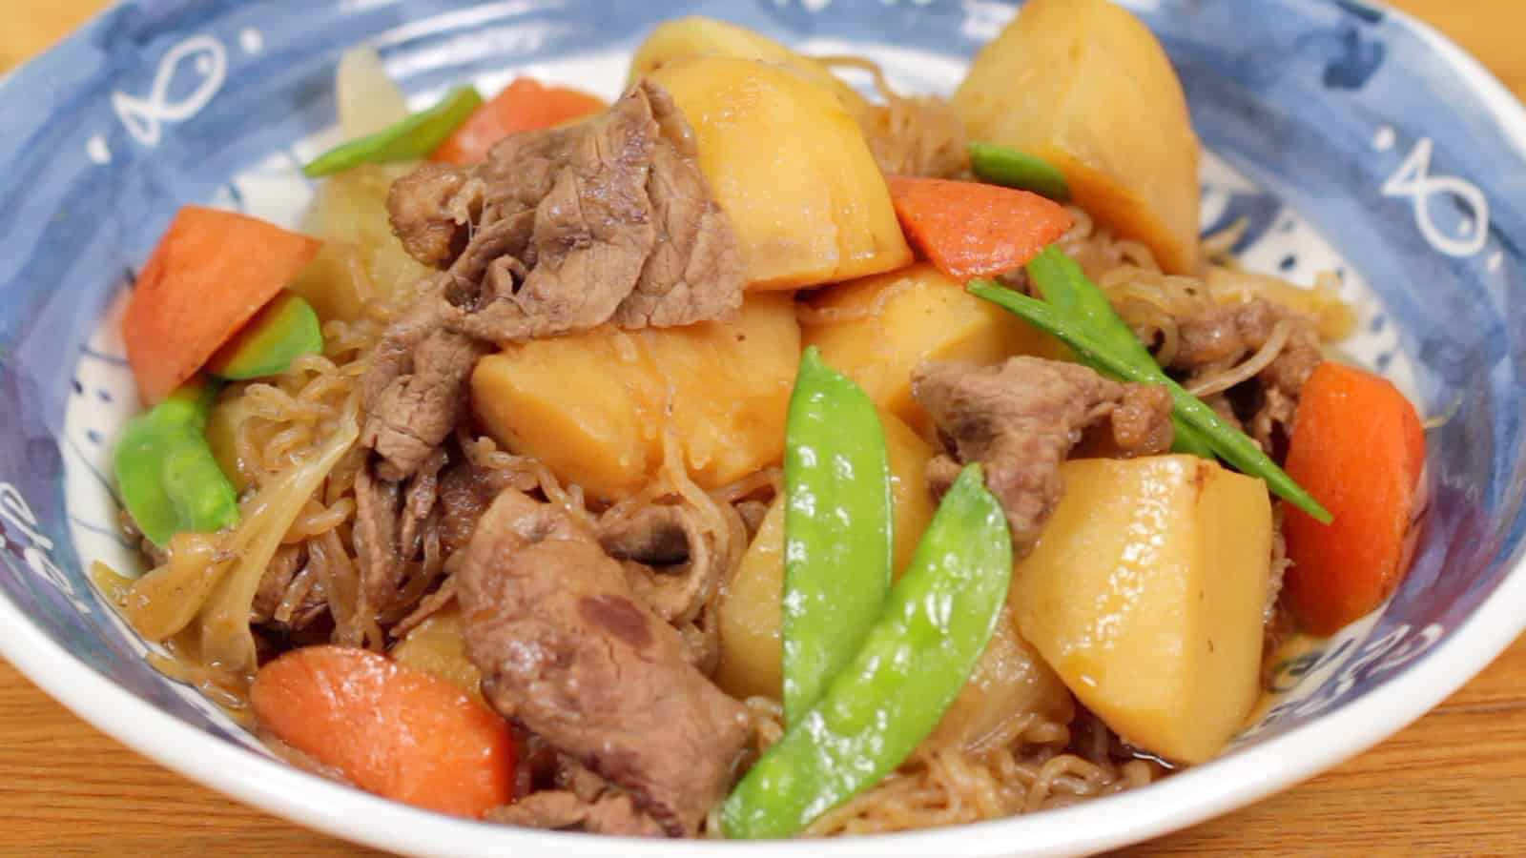
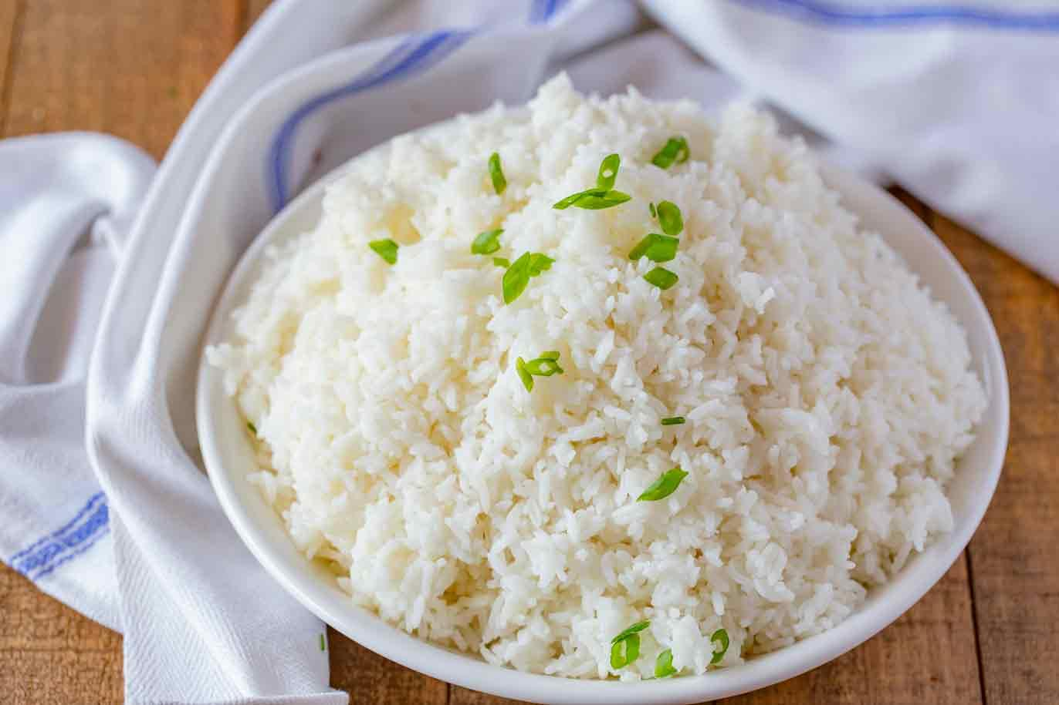
MEALS
KOJIKI
radishes. traditional breakfast.
MEAL | FOODS | TIME
BREAKFAST (朝ご飯) asa gohan | rice, miso soup, tofu, pickles such as radishes (takuan) or plums (umeboshi) and fish. slices of toast with butter and jam, eggs or chopped vegetables, accompanied by coffee and orange juice. | 8-10 am
LUNCH hiru gohan | Bento (弁当) is a take-away meal: white rice, fish or meat and pickled or cooked vegetables. | 13-15 pm
SNACK | a lot of japanese snacks | 17-19 pm
DINNER ban gohan | evergreen steamed white rice plus many small "side dish" courses with things like nikujaga, a meat soup and potatoes, or curry rice. | 21-23 pm
onighiri. sushi.
nikujaga. evergreen steamed white rice
(日本語)
3

Slide 9
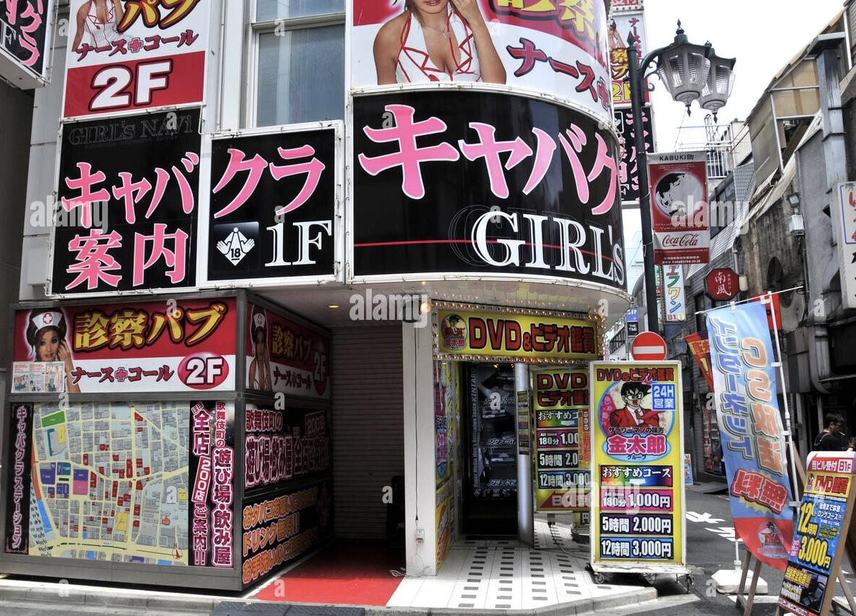
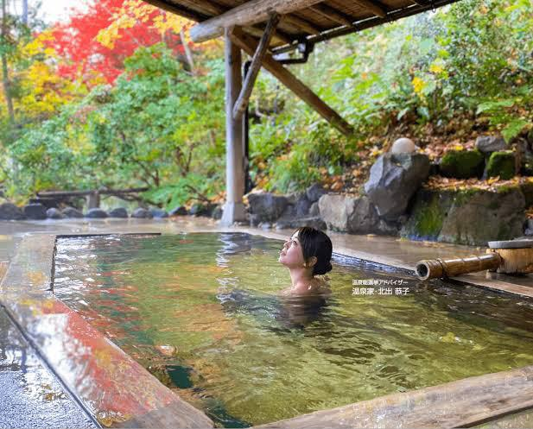
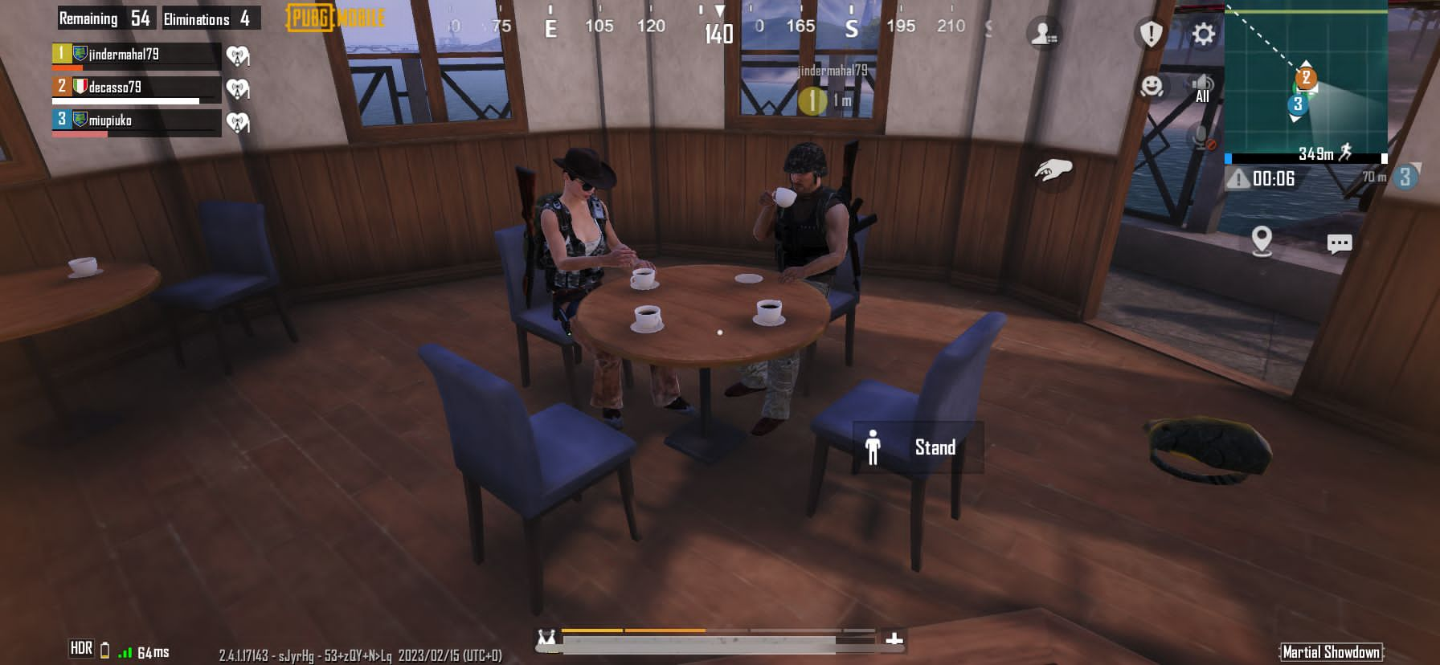
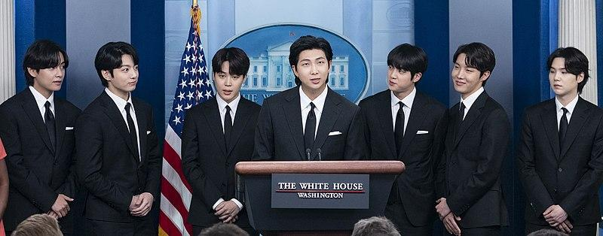
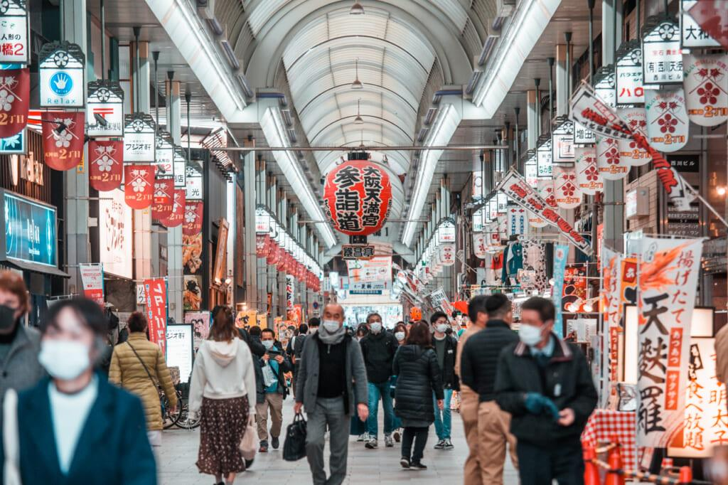
FUNNY ACTIVITIES
伝統
10

Slide 10
TRADITION
アレクサンダ
What are the celebration and the festival?
Where is Tokyo?
What are the main important things about the architecture?

Slide 11
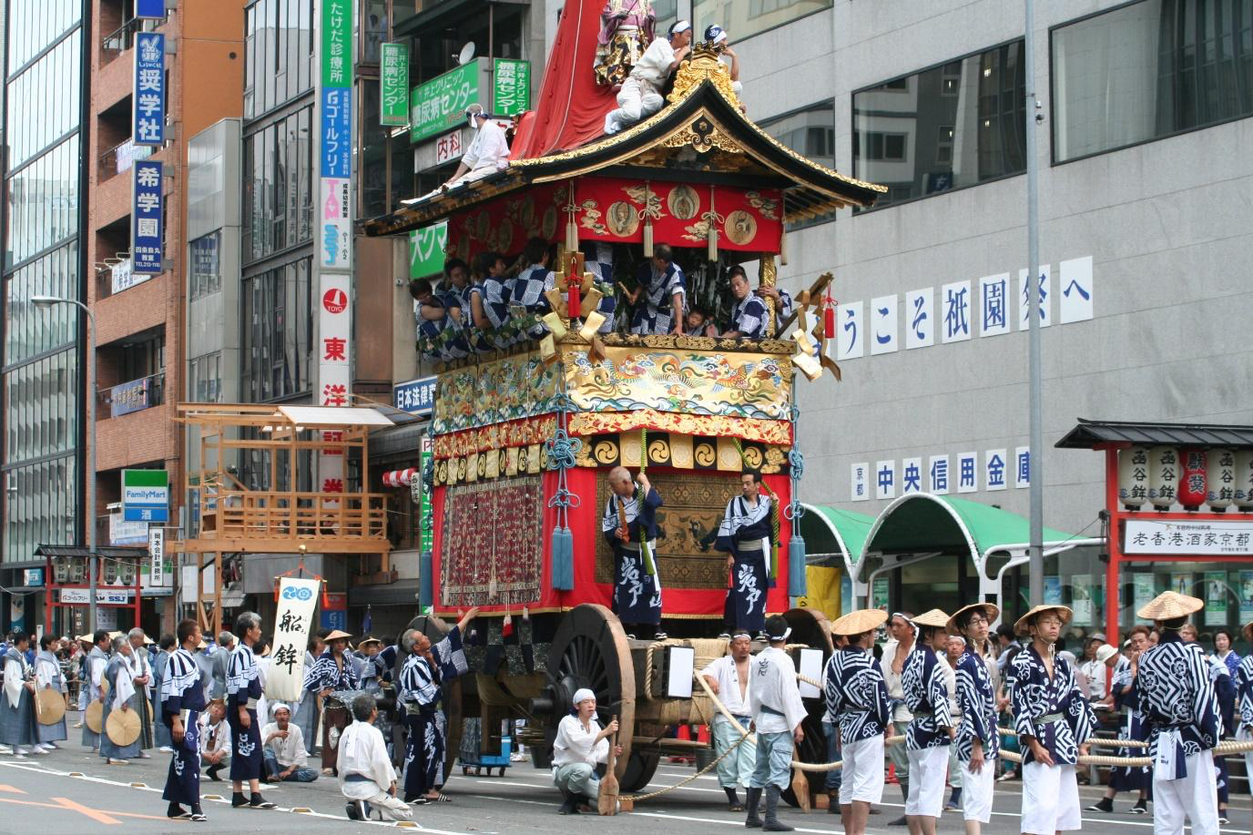
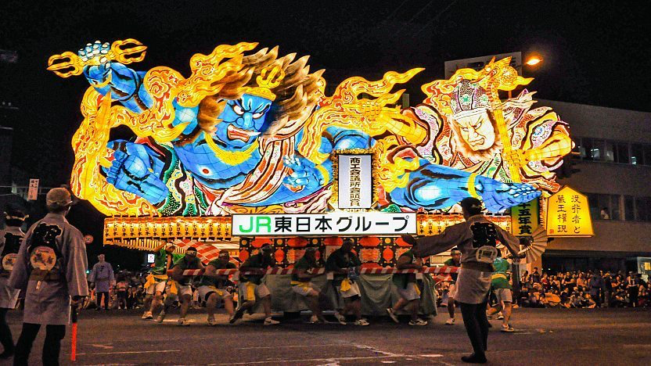
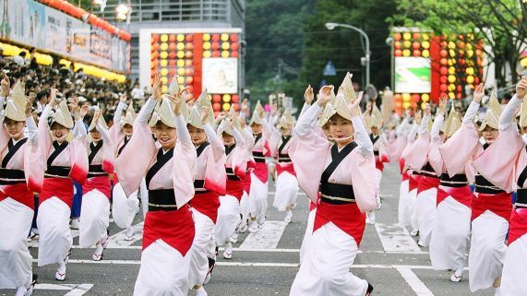
TRADITIONS
Festivals
Gion Festival in Kyoto
Nebuta Festival in Aomori
Awa Odori Festival in Tokushima
伝統
10

Slide 12
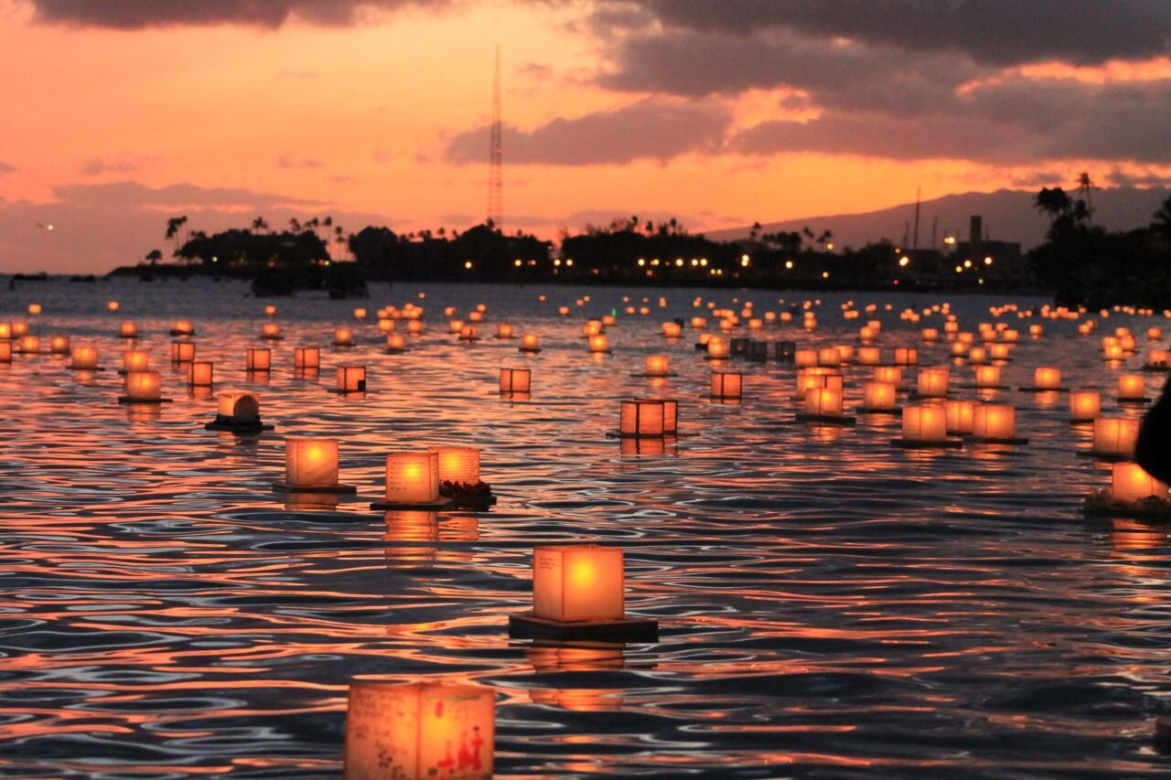
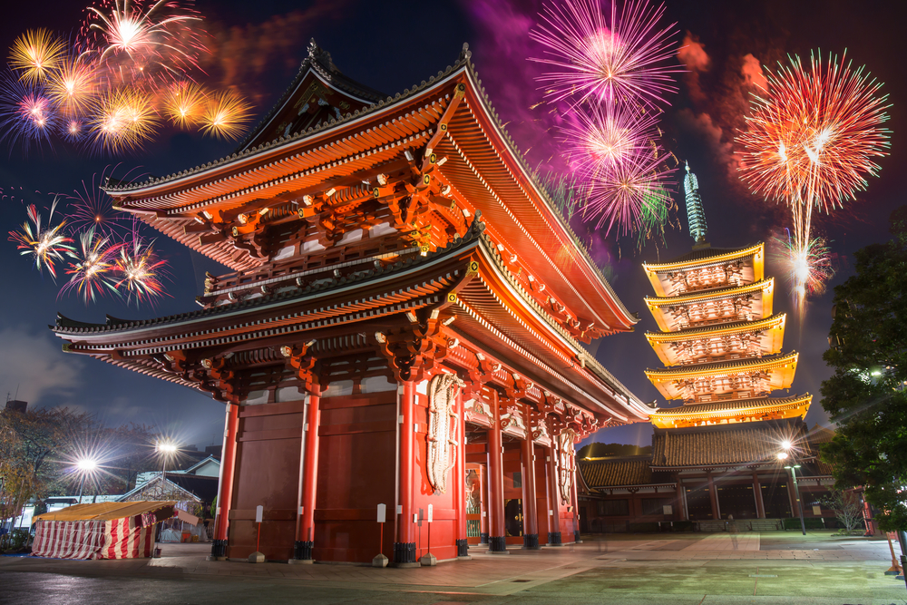
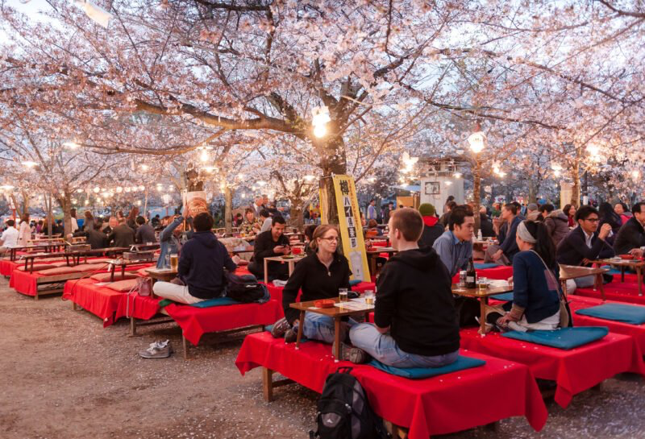
TRADITIONS
Celebrations
The Obon Holiday
The new year’s day
cherry blossom celebration
伝統
11

Slide 13
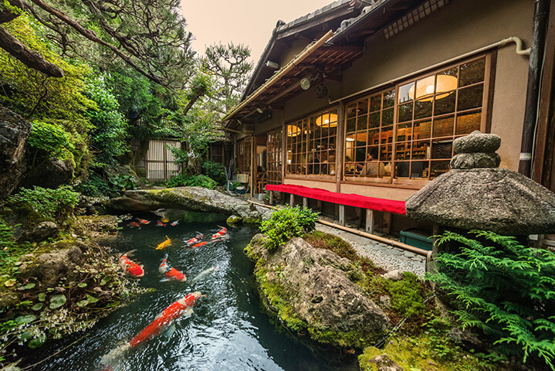
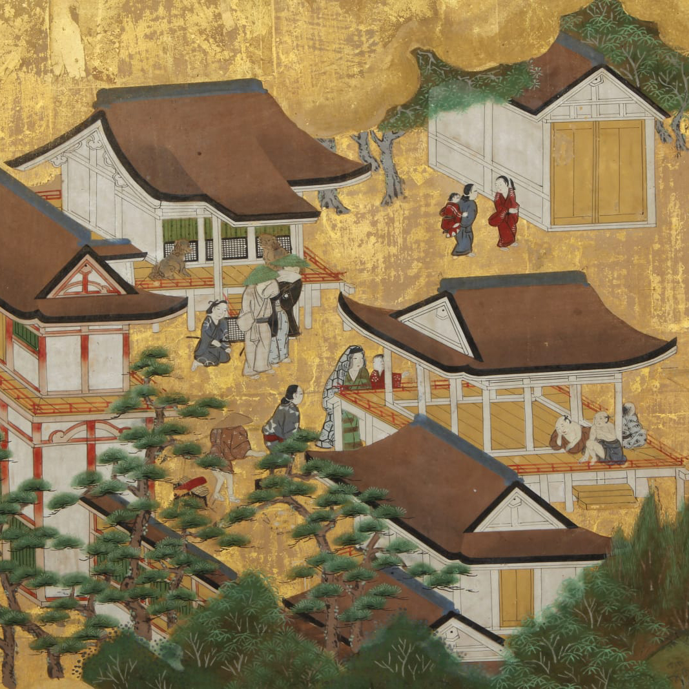
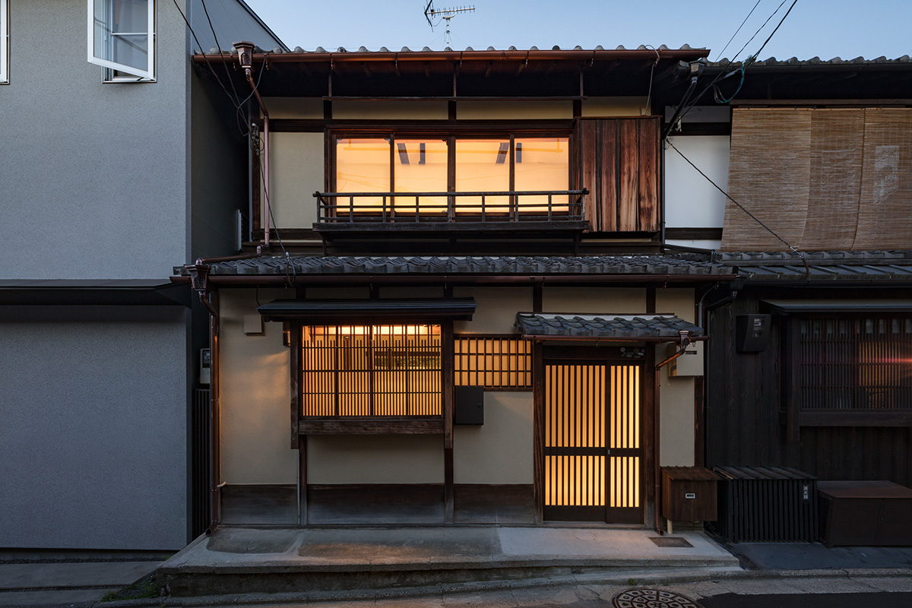
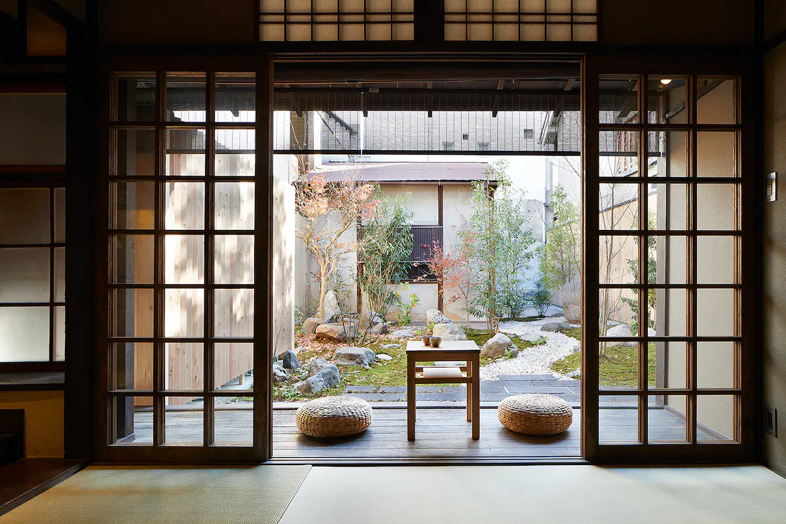
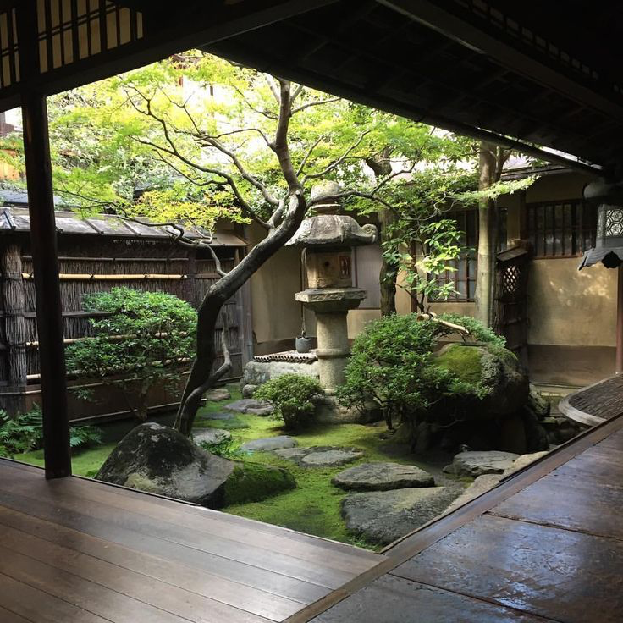
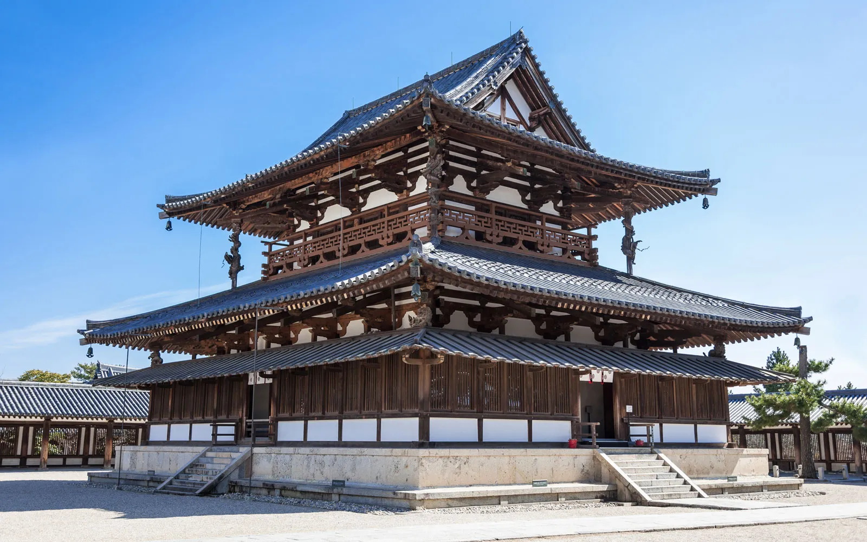
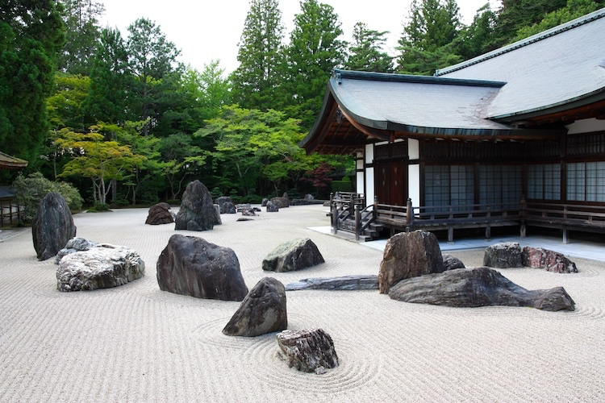
ARCHITECTURE
Houses and Gardens
The pond garden
The courtyard garden
The rock garden
12

Slide 14










TOKYO

Slide 15


THANK YOU

